Slide 1
Object-Oriented and
Classical Software Engineering
Sixth Edition, WCB/McGraw-Hill, 2005
Stephen R. Schach

Slide 2
Software Development in Practice
In the real world, software development is totally different .
We make mistakes.
The client’s requirements change while the software product is being developed.
Notes:
Artifacts are the by-products created during the development of software e.g. Use Case Diagrams, Documents , etc. An artifact is constructed piece wise and i.e. piece by piece (incrementation) and each increment goes through goes through multiple versions)iterations)
Workflows are activities.5

Slide 3
Winburg Mini Case Study
Set up public transportation system to reduce traffic congestion
Use bus-only lanes and park-and ride lots
Each bus fare machine accepts only dollar bills
Response must be fast (avg. < 1sec) and accurate (avg. 98% correct)

Slide 4
Winburg Mini Case Study (2)
Episode 1: The first version is implemented
Episode 2: A fault is found The product is too slow (avg. 10sec) because of an implementation fault (double precision vs single precision)
Changes to the implementation are begun
Episode 3: A new design is adopted Change will still be too slow.
A faster algorithm is used
Episode 4: The requirements change
Want to sell as a product to defray cost overrun
Accuracy must be increased to 99.5%
Finally, installation for city is complete
A few years later, these problems recur
New hardware => new software
New software => new design and programming language to be “better”

Slide 5
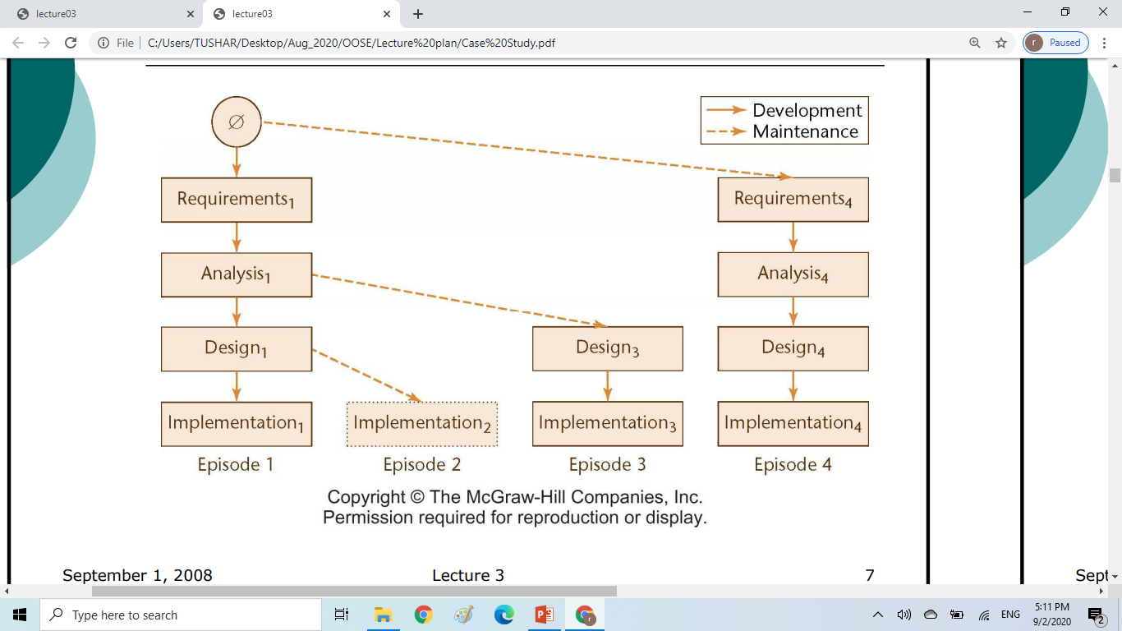
Winburg Case Study through evolution –tree-life-cycle

Slide 6
Lessons of the Winburg Mini Case Study
In the real world, software development is more chaotic than the Winburg mini case study
Changes are always needed :
A software product is a model of the real world, which is continually changing
Software professionals are human, and therefore make mistakes

Slide 7
Teal Tractors Mini Case Study
While its ERP software product is being constructed, the requirements change: The company is expanding into Canada
Changes needed include:
Additional sales regions must be added
Must be able to handle Canadian taxes and other business aspects that are handled differently , must be extended to handle two different currencies, US$ and CDN$
These changes may be great for the company; but Disastrous for the software product

Slide 8
Moving Target Problem
A change in the requirements while the software product is being developed
Even if the reasons for the change are good, the software product can be adversely impacted
Dependencies will be induced
Any change made to a software product can potentially cause a regression fault
A fault in an apparently unrelated part of the software
If there are too many changes the entire product may have to be redesigned and reimplemented.
Change is inevitable
Growing companies are always going to change
If the individual calling for changes has sufficient clout, nothing can be done about it
There is no solution to the moving target problem

Slide 9
Miller’s Law
At any one time, we can concentrate on only approximately seven chunks (units of information) .
To handle larger amounts of information, use stepwise refinement.
Concentrate on the aspects that are currently the most important .
Postpone aspects that are currently less critical.
Every aspect is eventually handled, but in order of current importance .
This is an incremental process.

Slide 10
Iteration and Incrementation
In real life, we cannot talk about “the analysis phase”
Instead, the operations of the analysis phase are spread out over the life cycle
The basic software development process is iterative
Each successive version is intended to be closer to its target than its predecessor
Iteration and incrementation are used in conjunction with one another
There is no single “requirements phase” or “design phase”
Instead, there are multiple instances of each phase
The number of increments will vary — e.g., Winburg Mini Case Study has four

Slide 11
Classical Phases versus Workflows
Sequential phases do not exist in the real world
Instead, the five core workflows (activities) are performed over the entire life cycle
Requirements workflow
Analysis workflow
Design workflow
Implementation workflow
Test workflow

Slide 12
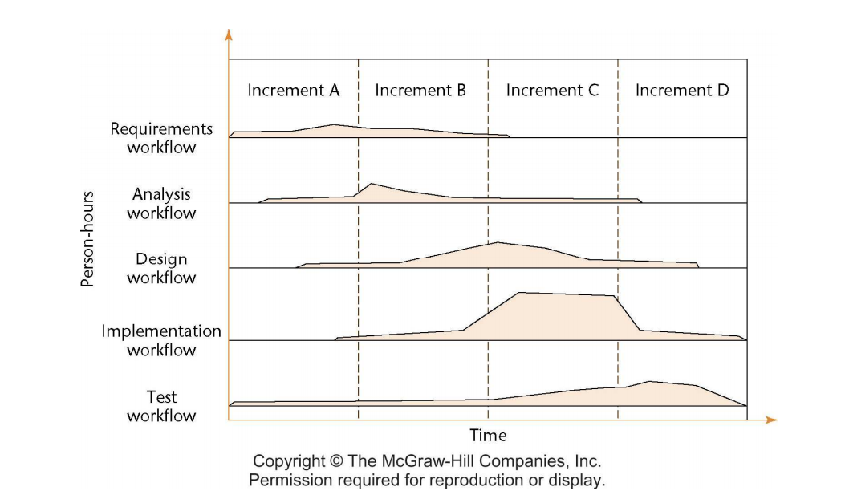
Iteration and Incrementation

Slide 13
Workflows
All five core workflows are performed over the entire life cycle
However, at most times one workflow predominates
Examples:
At the beginning of the life cycle
The requirements workflow predominates
At the end of the life cycle
The implementation and test workflows predominate
Planning and documentation activities are performed throughout the life cycle

Slide 14
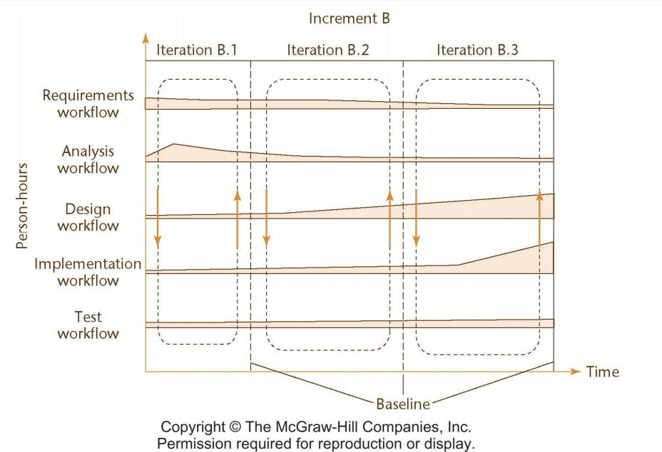
Iteration is performed during each incrementation

Slide 15
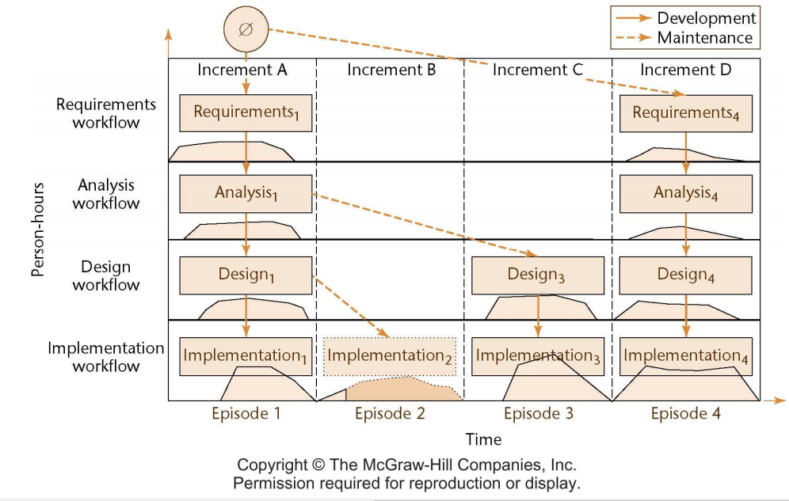
Winburg Mini Case Study Revisited

Slide 16
More on Incrementation
Each episode corresponds to an increment
Not every increment includes every workflow
Increment B was not completed
Dashed lines denote maintenance
Episodes 2, 3: Corrective maintenance
Episode 4: Perfective maintenance
We can consider the project as a whole as a set of mini projects (increments)
Each mini project extends the
Requirements artifacts
  Analysis artifacts
  Design artifacts
  Implementation artifacts
  Testing artifacts
The final set of artifacts is the complete product

Slide 17
3.1 The Unified Process
Until recently, three of the most successful object-oriented methodologies were
  Booch’s method
  Jacobson’s Objectory
  Rumbaugh’s OMT

Slide 18
The Unified Process (contd)
In 1999, Booch, Jacobson, and Rumbaugh published a complete object-oriented analysis and design methodology that unified their three separate methodologies
  Original name: Rational Unified Process (RUP)
  Next name: Unified Software Development Process (USDP)
  Name used today: Unified Process (for brevity)

Slide 19
The Unified Process (contd)
The Unified Process is not a series of steps for constructing a software product
  No such single “one size fits all” methodology could exist
  There is a wide variety of different types of software
The Unified Process is an adaptable methodology
  It has to be modified for the specific software product to be developed

Slide 20
The Unified Process (contd)
UML is graphical
  A picture is worth a thousand words
UML diagrams enable software engineers to communicate quickly and accurately

Slide 21
3.2 Iteration and Incrementation within the Object-Oriented Paradigm
The Unified Process is a modeling technique
  A model is a set of UML diagrams that represent various aspects of the software product we want to develop
UML stands for unified modeling language
  UML is the tool that we use to represent (model) the target software product

Slide 22
Iteration and Incrementation within the Object-Oriented Paradigm (contd)
The object-oriented paradigm is iterative and incremental in nature
  There is no alternative to repeated iteration and incrementation until the UML diagrams are satisfactory

Slide 23
The Phases of the Unified Process (contd)
The four increments are labeled
  Inception phase
  Elaboration phase
  Construction phase
  Transition phase
The phases of the Unified Process are the increments

Slide 24
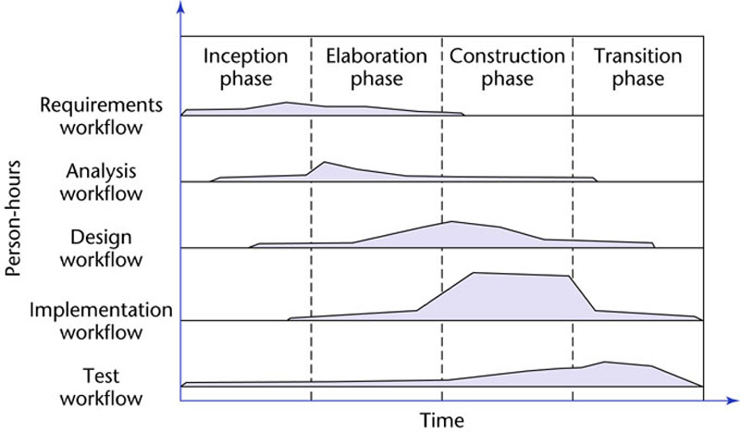
3.10 The Phases of the Unified Process
The increments are identified as phases
Figure 3.1

Slide 25
The Phases of the Unified Process (contd)
In theory, there could be any number of increments
  In practice, development seems to consist of four increments
Every step performed in the Unified Process falls into
  One of the five core workflows and also
  One of the four phases
Why does each step have to be considered twice?

Slide 26
The Phases of the Unified Process (contd)
Workflow
  Technical context of a step
Phase
  Business context of a step

Slide 27
3.10.1 The Inception Phase
The aim of the inception phase is to determine whether the proposed software product is economically viable.
Objectives of Inception Phase
1. Gain an understanding of the domain
2. Build the business model
3. Delimit the scope of the proposed project
  Focus on the subset of the business model that is covered by the proposed software product
4. Begin to make the initial business case

Slide 28
The Inception Phase : The Initial Business Case
Questions that need to be answered include:
  Is the proposed software product cost effective?
  How long will it take to obtain a return on investment?
  Alternatively, what will be the cost if the company decides not to develop the proposed software product?
  If the software product is to be sold in the marketplace, have the necessary marketing studies been performed?
  Can the proposed software product be delivered in time?
  If the software product is to be developed to support the client organization’s own activities, what will be the impact if the proposed software product is delivered late?

Slide 29
The Inception Phase: The Initial Business Case
What are the risks involved in developing the software product, and
How can these risks be mitigated?
  Does the team who will develop the proposed software product have the necessary experience?
  Is new hardware needed for this software product?
  If so, is there a risk that it will not be delivered in time?
  If so, is there a way to mitigate that risk, perhaps by ordering back-up hardware from another supplier?
  Are software tools needed?
  Are they currently available?
  Do they have all the necessary functionality?

Slide 30
The Inception Phase: The Initial Business Case
Answers are needed by the end of the inception phase so that the initial business case can be made

Slide 31
The Inception Phase: Risks
There are three major risk categories:
  Technical risks
  The risk of not getting the requirements right
    Mitigated by performing the requirements workflow correctly
  The risk of not getting the architecture right
    The architecture may not be sufficiently robust

Slide 32
The Inception Phase: Risks
To mitigate all three classes of risks
  The risks need to be ranked so that the critical risks are mitigated first
This concludes the steps of the inception phase that fall under the requirements workflow

Slide 33
The Inception Phase: Analysis, Design Workflows
A small amount of the analysis workflow may be performed during the inception phase
  Information needed for the design of the architecture is extracted
Accordingly, a small amount of the design workflow may be performed, too

Slide 34
The Inception Phase: Implementation Workflow
Coding is generally not performed during the inception phase
However, a proof-of-concept prototype is sometimes build to test the feasibility of constructing part of the software product

Slide 35
The Inception Phase: Test Workflow
The test workflow commences almost at the start of the inception phase
  The aim is to ensure that the requirements have been accurately determined

Slide 36
The Inception Phase: Planning
There is insufficient information at the beginning of the inception phase to plan the entire development
  The only planning that is done at the start of the project is the planning for the inception phase itself
For the same reason, the only planning that can be done at the end of the inception phase is the plan for just the next phase, the elaboration phase

Slide 37
The Inception Phase: Documentation
The deliverables of the inception phase include:
  The initial version of the domain model
  The initial version of the business model
  The initial version of the requirements artifacts
  A preliminary version of the analysis artifacts
  A preliminary version of the architecture
  The initial list of risks
  The initial ordering of the use cases (Chapter 10)
  The plan for the elaboration phase
  The initial version of the business case

Slide 38
The Inception Phase: The Initial Business Case
Obtaining the initial version of the business case is the overall aim of the inception phase
This initial version incorporates
  A description of the scope of the software product
  Financial details
  If the proposed software product is to be marketed, the business case will also include
    Revenue projections, market estimates, initial cost estimates
  If the software product is to be used in-house, the business case will include
    The initial cost–benefit analysis

Slide 39
3.10.2 Elaboration Phase
The aim of the elaboration phase is to refine the initial requirements
  Refine the architecture
  Monitor the risks and refine their priorities
  Refine the business case
  Produce the project management plan
The major activities of the elaboration phase are refinements or elaborations of the previous phase

Slide 40
The Tasks of the Elaboration Phase
The tasks of the elaboration phase correspond to:
  All but completing the requirements workflow
  Performing virtually the entire analysis workflow
  Starting the design of the architecture

Slide 41
The Elaboration Phase: Documentation
The deliverables of the elaboration phase include:
  The completed domain model
  The completed business model
  The completed requirements artifacts
  The completed analysis artifacts
  An updated version of the architecture
  An updated list of risks
  The project management plan (for the rest of the project)
  The completed business case

Slide 42
3.10.3 Construction Phase
The aim of the construction phase is to produce the first operational-quality version of the software product
  This is sometimes called the beta release

Slide 43
The Tasks of the Construction Phase
The emphasis in this phase is on
  Implementation, and
  Testing
    Unit testing of modules
    Integration testing of subsystems
    Product testing of the overall system

Slide 44
The Construction Phase: Documentation
The deliverables of the construction phase include:
  The initial user manual and other manuals, as appropriate
  All the artifacts (beta release versions)
  The completed architecture
  The updated risk list
  The project management plan (for the remainder of the project)
  If necessary, the updated business case

Slide 45
3.10.4 The Transition Phase
The aim of the transition phase is to ensure that the client’s requirements have indeed been met
  Faults in the software product are corrected
  All the manuals are completed
  Attempts are made to discover any previously unidentified risks
This phase is driven by feedback from the site(s) at which the beta release has been installed

Slide 46
The Transition Phase: Documentation
The deliverables of the transition phase include:
  All the artifacts (final versions)
  The completed manuals

Slide 47
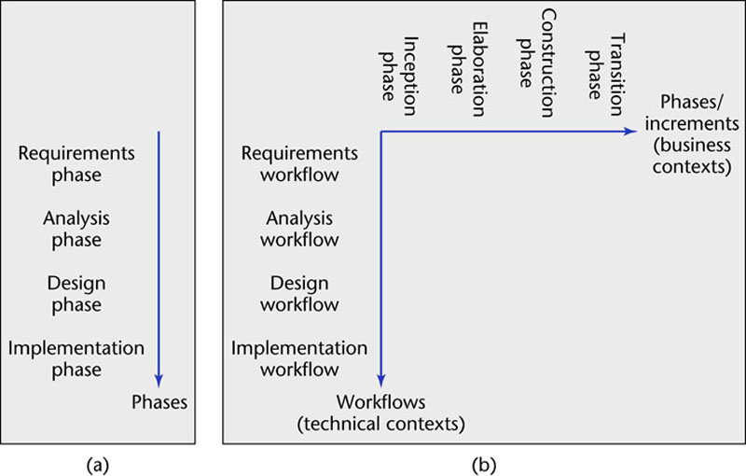
3.11 One- and Two-Dimensional Life-Cycle Models
Figure 3.2

Slide 48
Why a Two-Dimensional Model?
A traditional life cycle is a one-dimensional model
  Represented by the single axis on the previous slide
    Example: Waterfall model
The Unified Process is a two-dimensional model
  Represented by the two axes on the previous slide
The two-dimensional figure shows
  The workflows (technical contexts), and
  The phases (business contexts)

Slide 49
Why a Two-Dimensional Model?
Are all the additional complications of the two-dimensional model necessary?
In an ideal world, each workflow would be completed before the next workflow is started

Slide 50
Why a Two-Dimensional Model?
In reality, the development task is too big for this
As a consequence of Miller’s Law
  The development task has to be divided into increments (phases)
  Within each increment, iteration is performed until the task is complete

Slide 51
Why a Two-Dimensional Model?
At the beginning of the process, there is not enough information about the software product to carry out the requirements workflow
  Similarly for the other core workflows
A software product has to be broken into subsystems
Even subsystems can be too large at times
  Modules may be all that can be handled until a fuller understanding of all the parts of the product as a whole has been obtained

Slide 52
Why a Two-Dimensional Model?
The Unified Process handles the inevitable changes well
  The moving target problem
  The inevitable mistakes
The Unified Process is the best solution found to date for treating a large problem as a set of smaller, largely independent subproblems
  It provides a framework for incrementation and iteration
  In the future, it will inevitably be superseded by some better methodology

Slide 53
ISO 9000
A set of five standards for industrial activities
  ISO 9001 for quality systems
  ISO 9000-3, guidelines to apply ISO 9001 to software
  There is an overlap with CMM, but they are not identical
  Not process improvement
  There is a stress on documenting the process
  There is an emphasis on measurement and metrics
  ISO 9000 is required to do business with the EU
  Also required by many U.S. businesses, including GE
  More and more U.S. businesses are ISO 9000 certified

Slide 54
ISO/IEC 15504
Original name: Software Process Improvement Capability determination (SPICE)
  International process improvement initiative
  Started by the British Ministry of Defence (MOD)
  Includes process improvement, software procurement
  Extends and improves CMM, ISO 9000
  A framework, not a method
    CMM, ISO 9000 conform to this framework
  Now referred to as ISO/IEC 15504
  Or just 15504 for short

Slide 55
Costs and Benefits of Software Process Improvement (contd)
There is interplay between
  Software engineering standards organizations, and
  Software process improvement initiatives
ISO/IEC 12207 (1995) is a full life-cycle software standard
In 1998, the U.S. version (IEEE/EIA 12207) was published that incorporated ideas from CMM
ISO 9000-3 now incorporates part of ISO/IEC 12207

